Slide 1


ZEESF LLC
FROM SPARKLES TO STEEL

Slide 2
PERSPECTIVE
ZEESF is a leading engineering company to provide a range of professional, smart engineering and procurement services in the sectors of Oil & Gas, Power, Cement, Fertilizer, Renewable Energy, Chemical Process Industries and Petrochemicals.
ZEESF offers common engineering services along with specialized services including process design, mechanical design, steel structure design, civil design, engineering reviews, proposal preparation, cost estimation, preparation of bill of materials & procurement support.
ZEESF has a dedicated group of expert engineers to provide cutting edge IT related services ranges from software development, Software consultation, software quality assurance/testing, cloud & DevOps services, data science & artificial intelligence (AI), UX/UI Design, IT Support/Maintenance, E-Commerce, social media marketing etc.
FROM SPARKLES TO STEEL

Slide 3
MISSION
ZEESF is focused to provide the unmatched engineering, IT, procurement & supply chain services to our esteemed clients . We are driven to deliver superior results through innovation, precision, and collaboration. Our mission is to empower our clients by aligning strategic insights with practical solutions, ensuring measurable success at every step to have sustainable business growth.
FROM SPARKLES TO STEEL

Slide 4
SCOPE ZEESF’S SERVICE SCOPE
Project Feasibility
Conceptual Design Study
Basic Engineering Design
Project Documentation
Detail Engineering Design
Supply Chain
FROM SPARKLES TO STEEL

Slide 5
EXECUTION STRATEGY
Improve the Solution
Define a Problem
Identify what’s needed to solve the problem
Evaluate Result
Share Result
Brainstorm Solutions
Make a test the best Solution
FROM SPARKLES TO STEEL

Slide 6
ZEESF SERVICES
Front End Engineering Design (FEED)
Process Engineering
Mechanical Engineering
Structural & Civil Engineering
Supply Chain & Procurement Services
FROM SPARKLES TO STEEL

Slide 7
ZEESF SERVICES
Services Control Systems Engineering (Instrumentation and Automation)
Drafting Services
Other Services
IT Services
FROM SPARKLES TO STEEL

Slide 8
FLOW CHART OF DESIGN & ENGINEERING
FROM SPARKLES TO STEEL

Slide 9
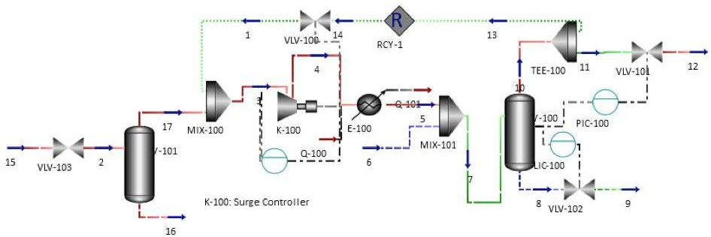
Front End Engineering Design (FEED)
Define the specific project requirements for the ease of Detailed Engineering, Procurement & Construction.
Project cost estimates & Evaluation for project cost optimization.
Process flow sheets, heat & material balances.
Project execution plan and project execution schedule.
Process Design Basis
Process Descriptions
Process Equipment Data Sheets
Equipment List
Specification for Packaged Equipment
PSV Sizing
Lining Sizing
Process Engineering
FROM SPARKLES TO STEEL

Slide 10
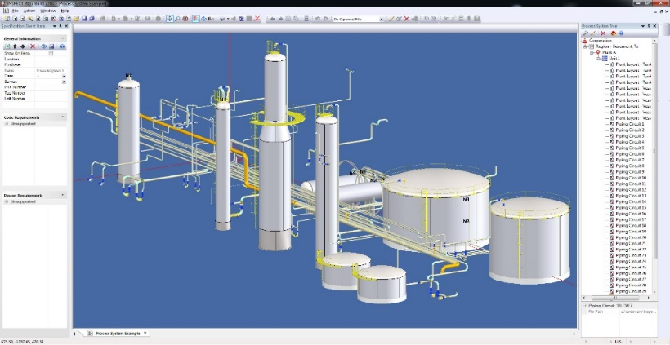
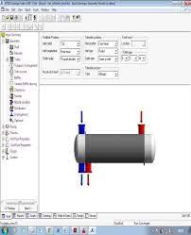
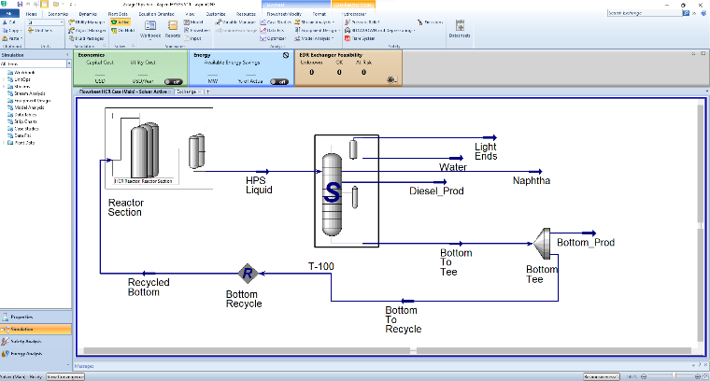
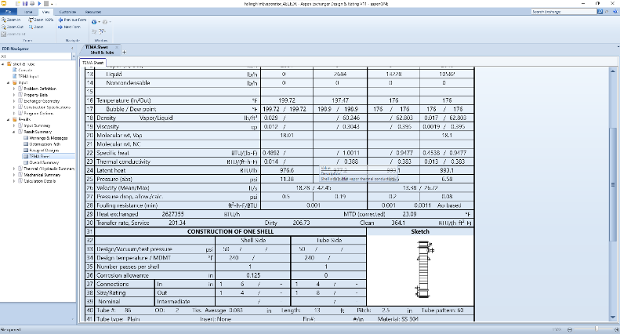
Process Simulations
Hydrocarbon Dew point Control
Dehydration Plants
Gas Recovery Plants
Gas Sweetening Plants
Scrubber Packages
Separator Packages like 2 & 3 Phase separators, Heavy crude separators & Test separators
Tail Gas Clean-up Packages
Chemical Injection Package
Industrial Refrigeration Systems
Gas Conditioning Package
FROM SPARKLES TO STEEL

Slide 11
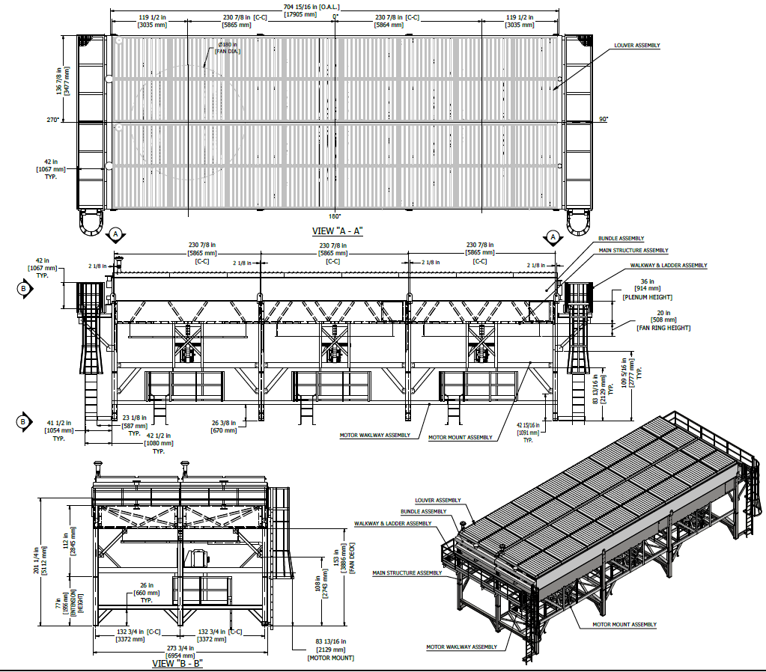
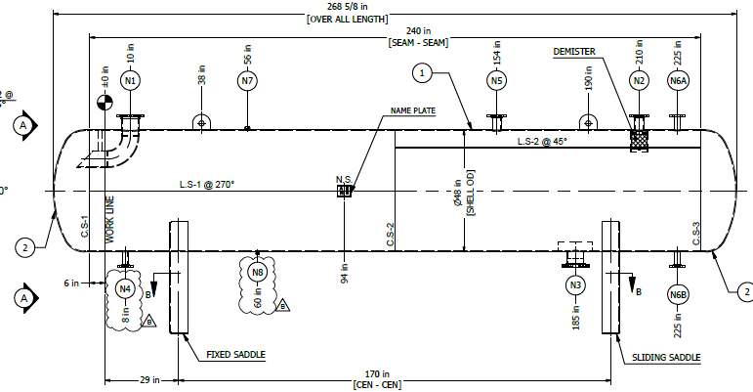
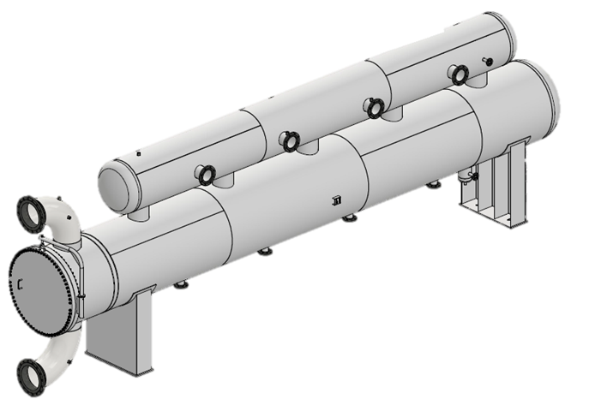
Process Equipment Sizing
2 Phase separators
3 Phase separators
KOD's
Filter Separators
Oil Separators
Scrubbers
Storage Tanks
S & T Heat Exchangers
Air Cooled Heat Exchangers
FROM SPARKLES TO STEEL

Slide 12
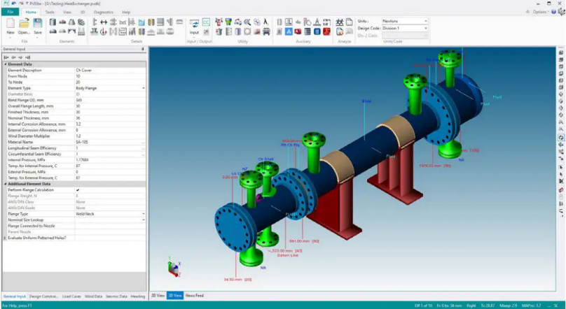
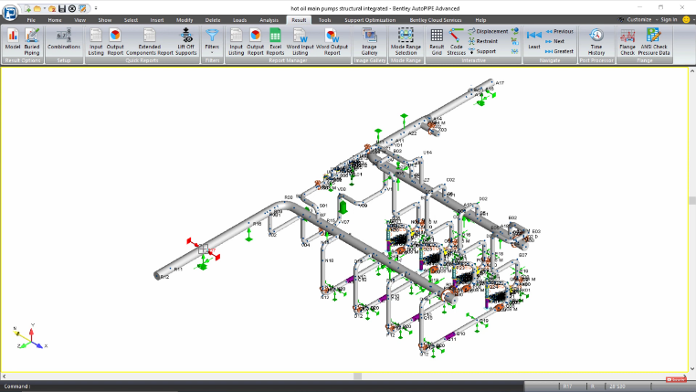
Mechanical Engineering
Mechanical Design Calculations for Static Equipment per ASME Section 1, Section VIII Div.1 & Div.2, TEMA, API-660, API-661, API-650, API-620 & others applicable codes & Standards.
Mechanical Equipment Specifications
Preparation of Insulation and Painting Specifications
Vendor Data / Drawing Review
Rotating Equipment Specifications & Datasheets
Pipe Design Calculations
Piping Material Specification
Data sheets and Specifications for Piping
Pipe Support Design
FE Analysis
Cyclic Load Analysis
Technical specifications, Tender Bid Evaluation and Purchase
Recommendations
FROM SPARKLES TO STEEL

Slide 13
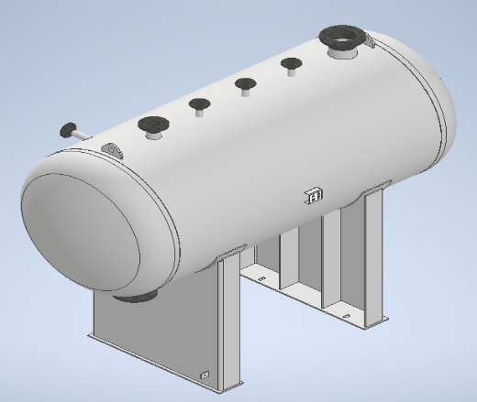
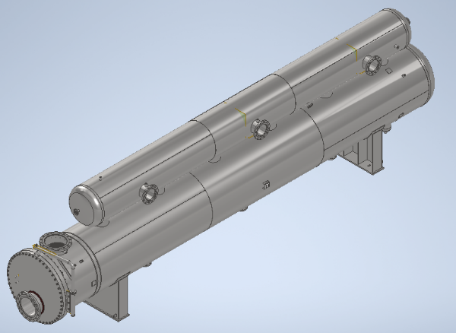
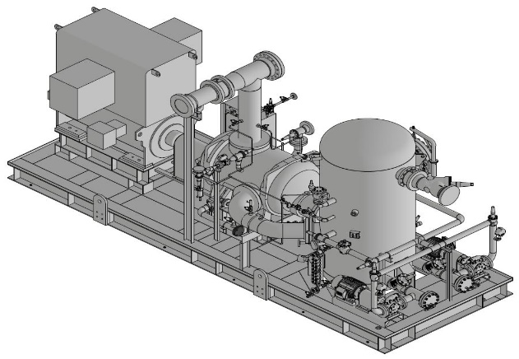
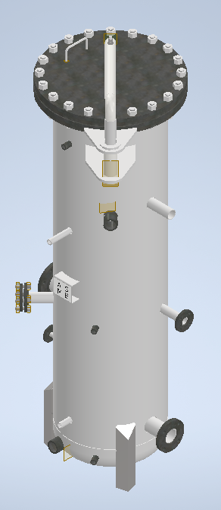
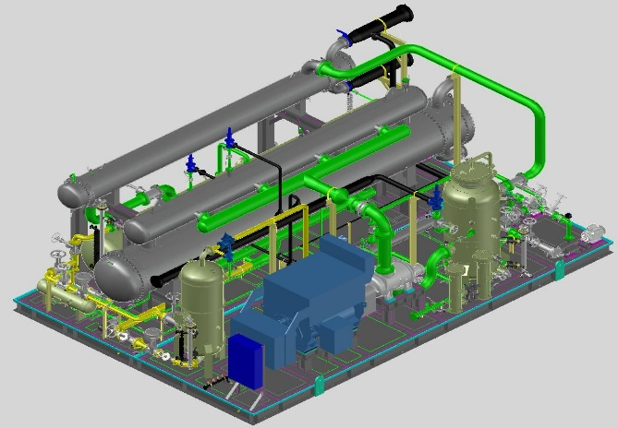
CFD Analysis
Piping Stress Analysis
PFDs, P & IDs
Plot Plan / Equipment Layout development, Piping & Pipe Support Detailing. (3D Design tool (CADWorx Plant) producing extremely accurate models of design & 2-D drafting tools to produce deliverables and drawings)
Skid Based System’s Detail Fabrication drawings
Detailed Fabrication Drawings for Static Equipment
Piping Isometric Drawings
Drafting Services
FROM SPARKLES TO STEEL

Slide 14
Structural & Civil Engineering
ZEESF specializes in advanced structural analysis and design of civil infrastructures and heavy industrial facilities, with an emphasis on mission-critical infrastructures, including nuclear power plants, hydro-power generation infrastructure, and power generation and distribution structures. The ZEESF team possesses extensive experience in designing concrete, steel, and steel composite structures from the conceptual design phase up to delivering Design Control Documents (DCD).
We offer explicit/implicit high-fidelity structural analyses, including Coupled Thermal Structural Analyses, Fire Load modeling, impact analysis, high-speed impact analyses, Fluid Structure Interaction Modeling (FSI), and Soil Structure Interaction modeling (SSI)
Design of Reinforced Concrete, Steel, and Steel Composite structures, including:
  Industrial facilities and warehouses
  Power generation and distribution structures
  Substation structures
  Residential mid-rise buildings (10-15 stories, concrete or steel systems
FROM SPARKLES TO STEEL

Slide 15
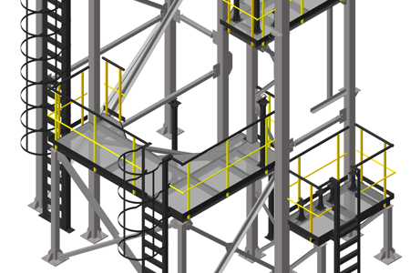
Structural & Civil Engineering
Seismic design and analysis for structures
Performing time history Soil Structure Interaction Analyses (SSI)
Designing structures and equipment mounts for dynamic and vibration loads
Performing Coupled Thermal Structural Analyses
Designing structures and systems for fire and accidental thermal loads
Designing structures and systems for high-speed impact
Performing blast load analyses
Designing blast-resistant structures
Performing Fluid Structure Interaction analyses (FSI)
Design of water resources structures
Skid Packages Structure
Static Equipment Structure
Boiler Complete Structure
Piping Rack & Pipe Supports
FROM SPARKLES TO STEEL

Slide 16
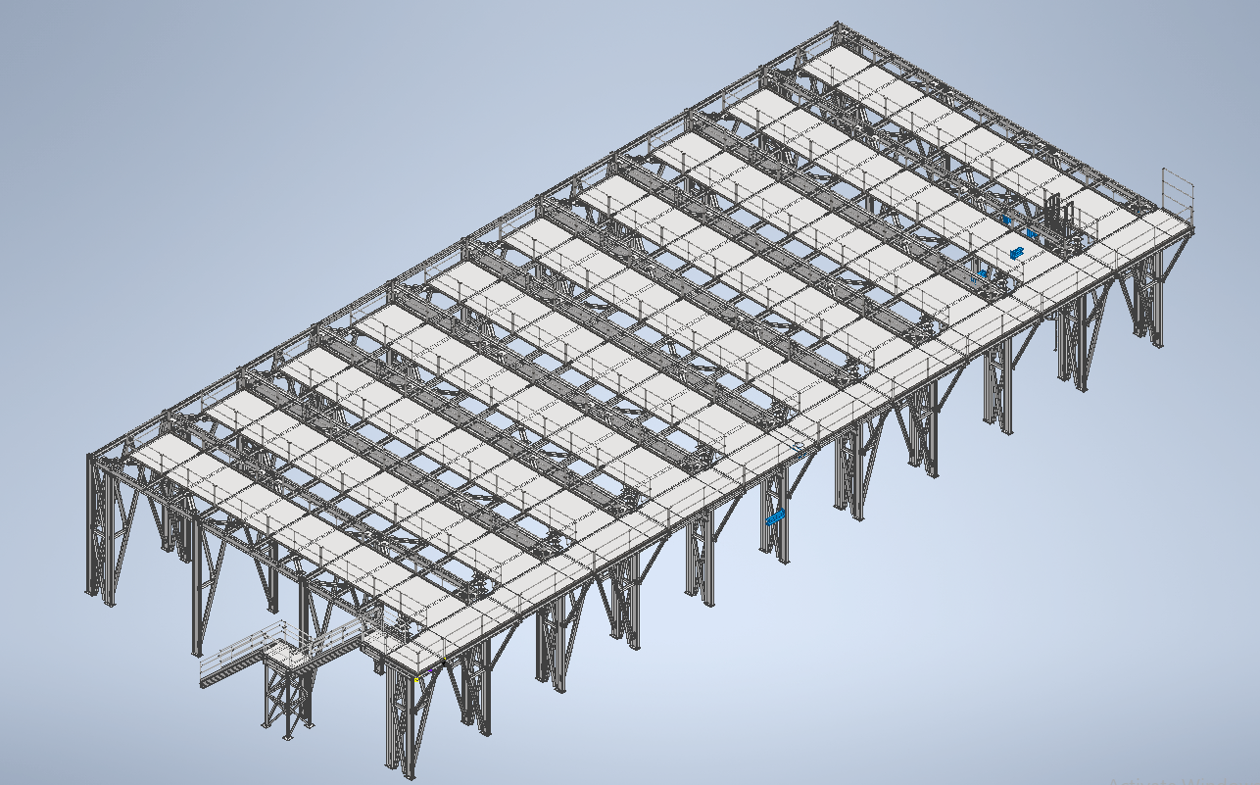
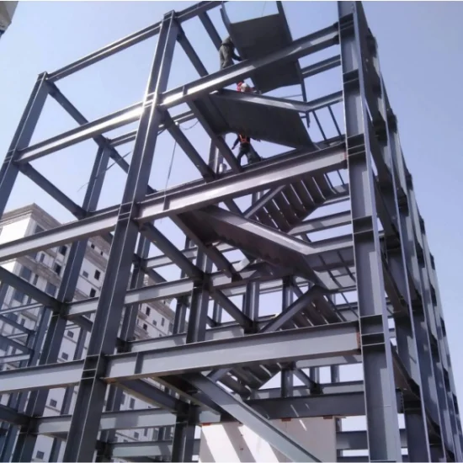
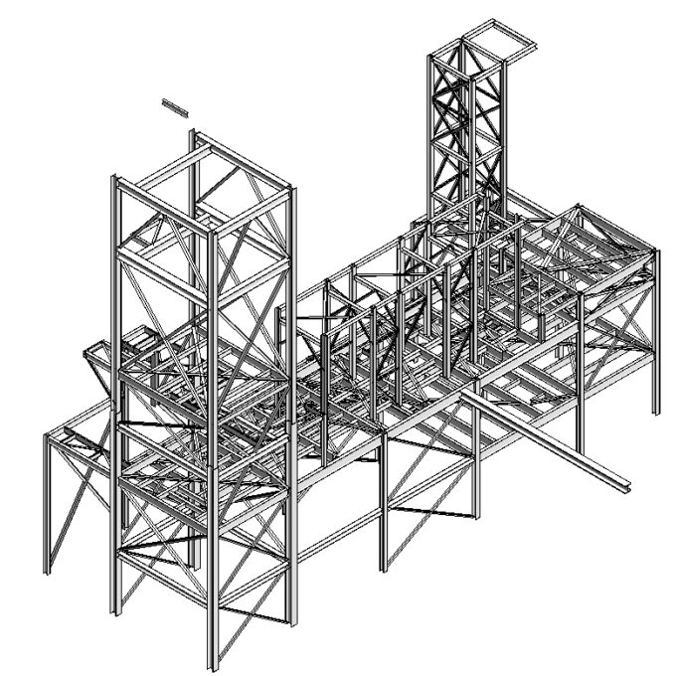
Structural & Civil Engineering
FROM SPARKLES TO STEEL

Slide 17
Pre-Engineering Buildings
Flare Stacks
Lifting and Transportation Analysis
PE Stamp on structural Design Calc & Drawings
ZEESF also offer services to generate Bill of Materials & fabrication drawings development for above list.
Design review (P&IDs, control system, System Architecture etc.)
Front End Engineering
Detail Engineering
Construction support documents (i.e., layouts, Diagrams)
Materials Requisition/Technical Evaluation of devices (Control Valves, Fire and Gas Devices, Instruments etc.)
Control Systems Engineering (Instrumentation and Automation
FROM SPARKLES TO STEEL

Slide 18
Other Services
Cost Estimation & Proposal Preparation
Procurement Support (Requisitions, Technical evaluation etc.)
Consultancy services for fabrication and manufacturing
Preparation of Costumers Specifications, Process Datasheets, Pre-BOM & RFQ Documentation
Data sheet, Specifications & Material Requisitions preparation (for RFQ). Bid Clarifications (TCLs), Technical Bid evaluation (TBEs) and Report, Vendor document review, Vendor-shop review and evaluations.
Support to Conduct ASME Audits (ASME Section VIII, DIV. 1/DIV. 2, ASEM Section I, NB R- Stamp)
Support to Conduct ISO9001:2015 & ISO14001:2015 Audits
FROM SPARKLES TO STEEL

Slide 19
Supply Chain & Procurement Services
Pipes & Plates that Covers All Materials per ASME Section II.
Plain & Low Fin Tubes.
All Types of Flanges per ASME, DIN etc.
All Type of Valves & Control System.
Instrumentations.
Filter Elements, Demister Pads & Coalescing Elements.
Used Machines, vessels, tanks & other equipment.
Misc. Items Procurement Support.
FROM SPARKLES TO STEEL

Slide 20
IT Services
ZEESF has a dedicated group of expert engineers to provide following cutting edge IT related services:
Custom Software Development
Software Consulting & Architecture
Quality Assurance & Testing
Cloud & DevOps Services
Data Science & Artificial Intelligence (AI)
UX/UI Design
IT Support & Maintenance
E-commerce Development
Agile Software Development
FROM SPARKLES TO STEEL

Slide 21
Engineering Software
At ZEESF LLC, we use the most cutting-edge engineering design tools to deliver superior engineering solutions that satisfy our clients' intricate needs. For precise calculations, design, simulation, and optimization for a variety of engineering applications, our team makes use of a number of industry-leading tools. The main design program we use is listed below:
ASPEN Plus
Autodesk Inventor
Solidworks
CADWokx Plant
Codeware Compress
HTRI
SAP2000
Excel Spreadsheets
FROM SPARKLES TO STEEL

Slide 22
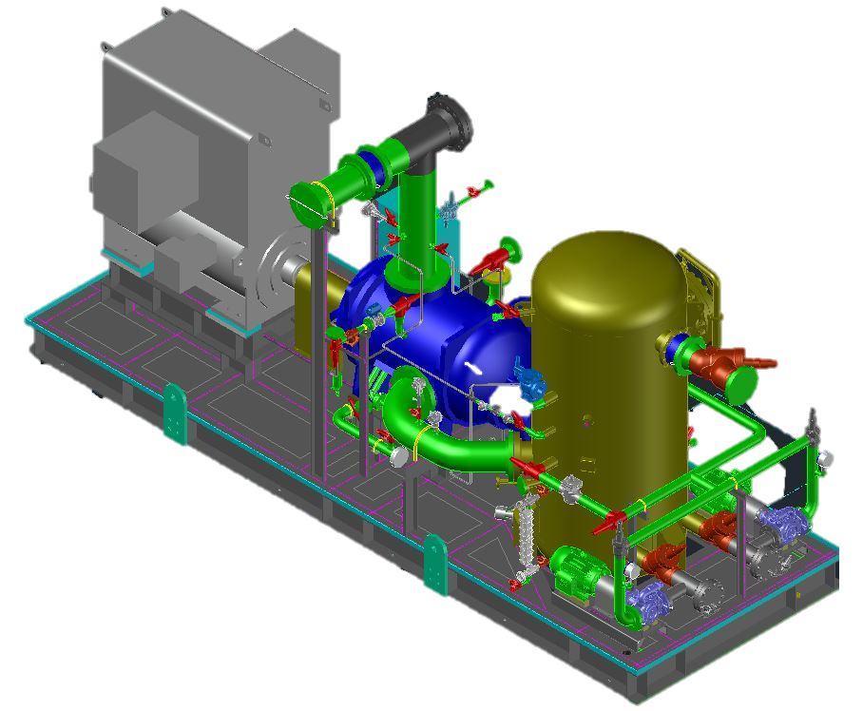
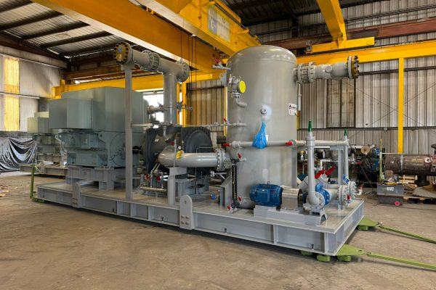
ZEESF Project Highlights
    7,000-ton refrigeration system with a skid-mounted oil separator and compressor, showcasing the ZEESF's advanced design and engineering efficiency. (3x33%)
FROM SPARKLES TO STEEL

Slide 23
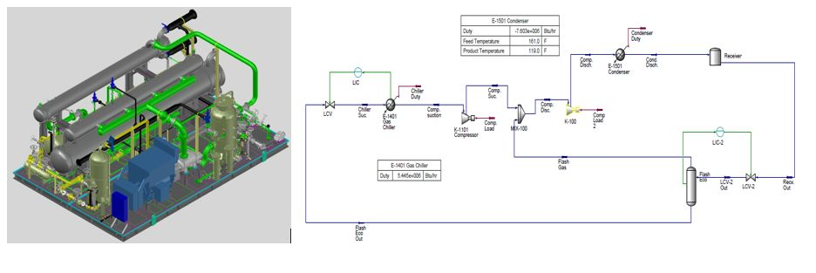
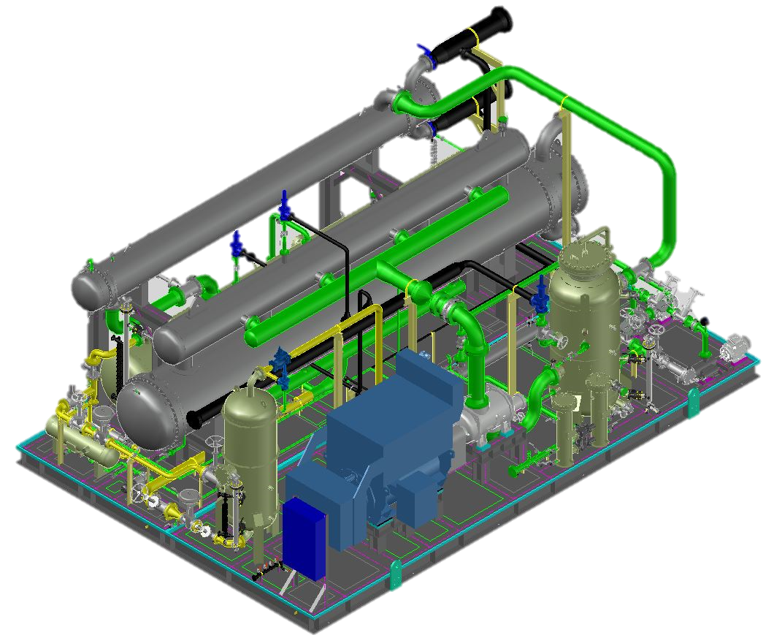
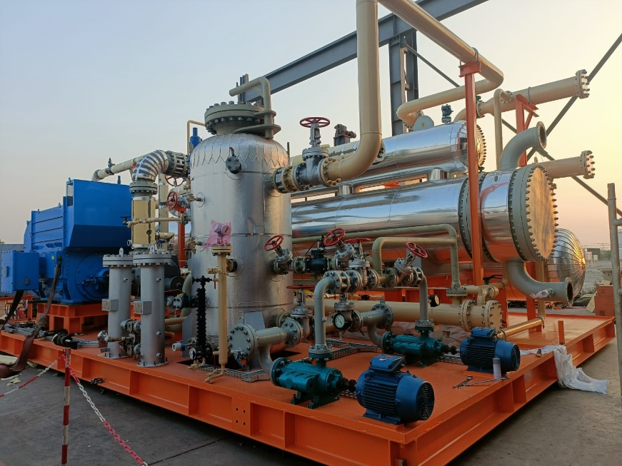
ZEESF Project Highlights
    Propylene Refrigeration Package used to chill brine solution from -5°C to -10 °C
FROM SPARKLES TO STEEL

Slide 24
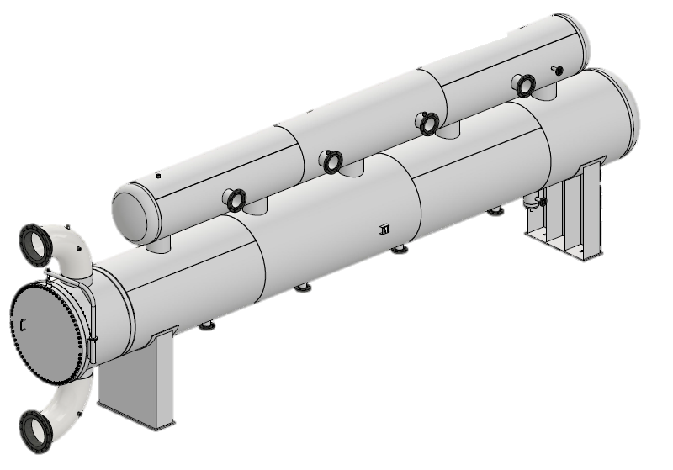
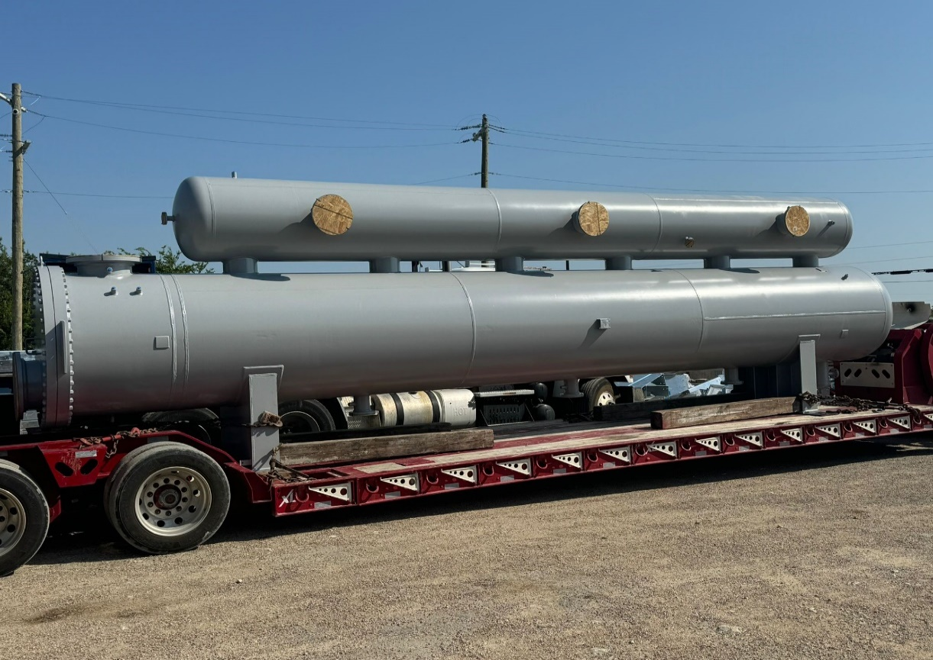
ZEESF Project Highlights
    ZEESF performer flooded chiller’s thermal, mechanical design & detailed fabrication drawings which were part of 7000 TR refrigeration system. (4 Flooded chillers)
FROM SPARKLES TO STEEL

Slide 25
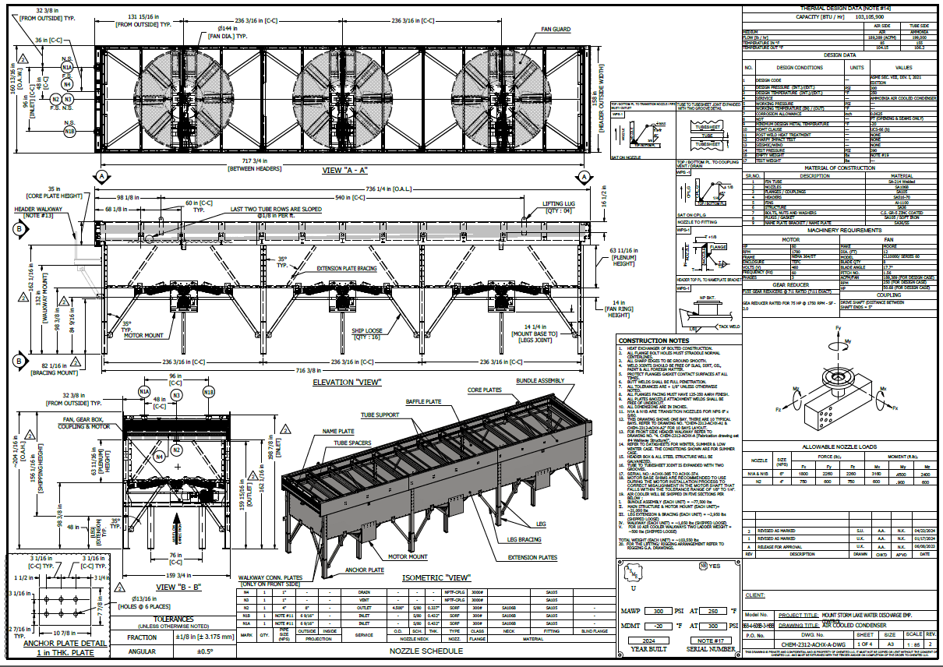
ZEESF Project Highlights
    14 ft wide x 60 ft long air cooled ammonia condenser’s thermal & detailed engineering performed by ZEESF.
FROM SPARKLES TO STEEL

Slide 26
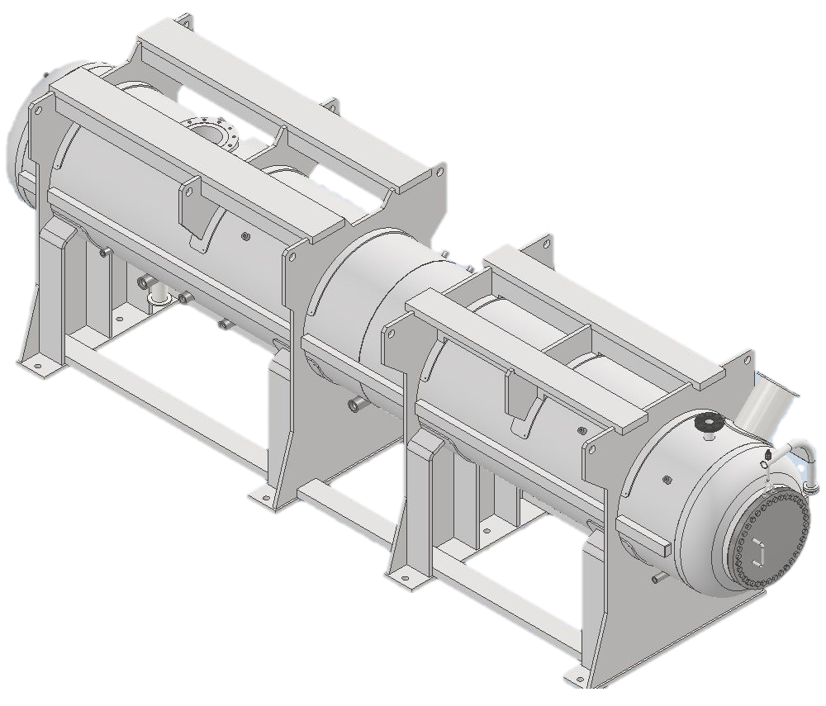
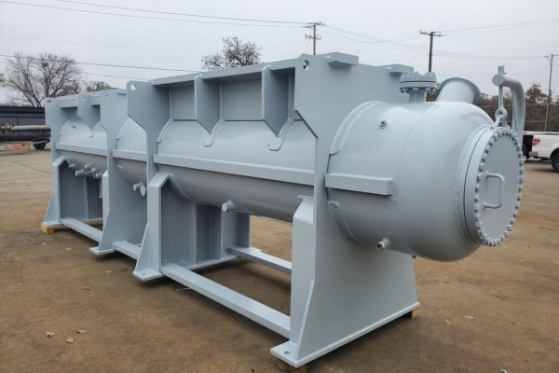
ZEESF Project Highlights
    Oil Separators with compressor and motor mountings
FROM SPARKLES TO STEEL

Slide 27
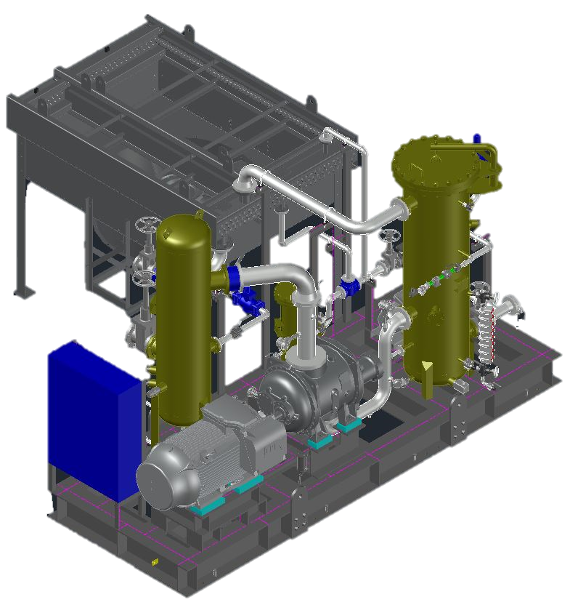
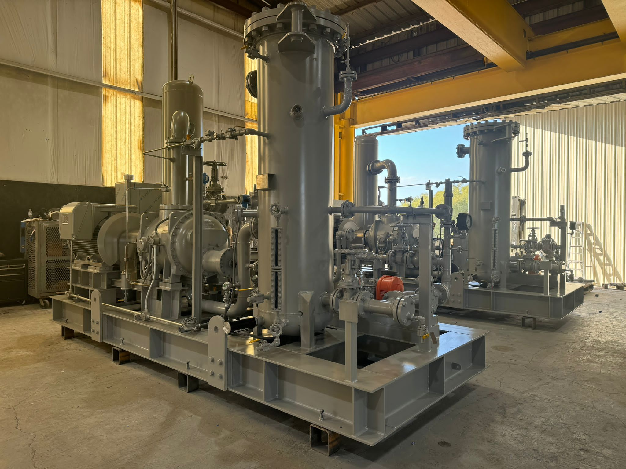
ZEESF Project Highlights
    3 MMSFD Gas Compression Skids (2x100%)
FROM SPARKLES TO STEEL

Slide 28
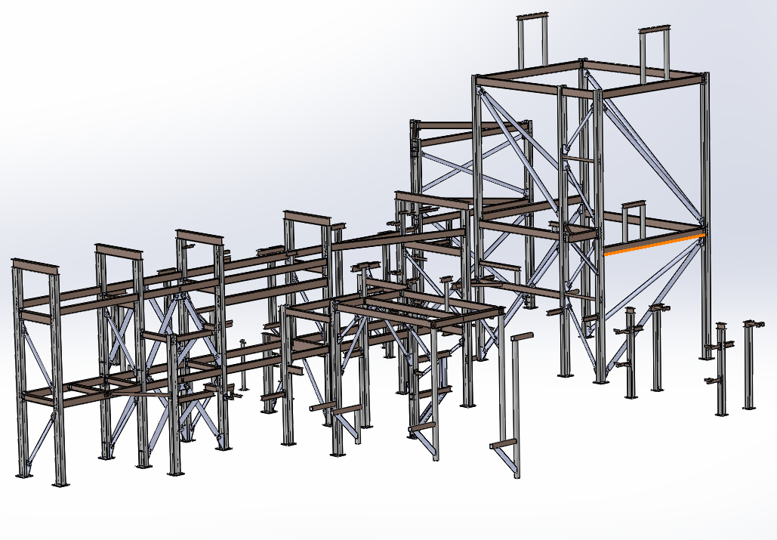
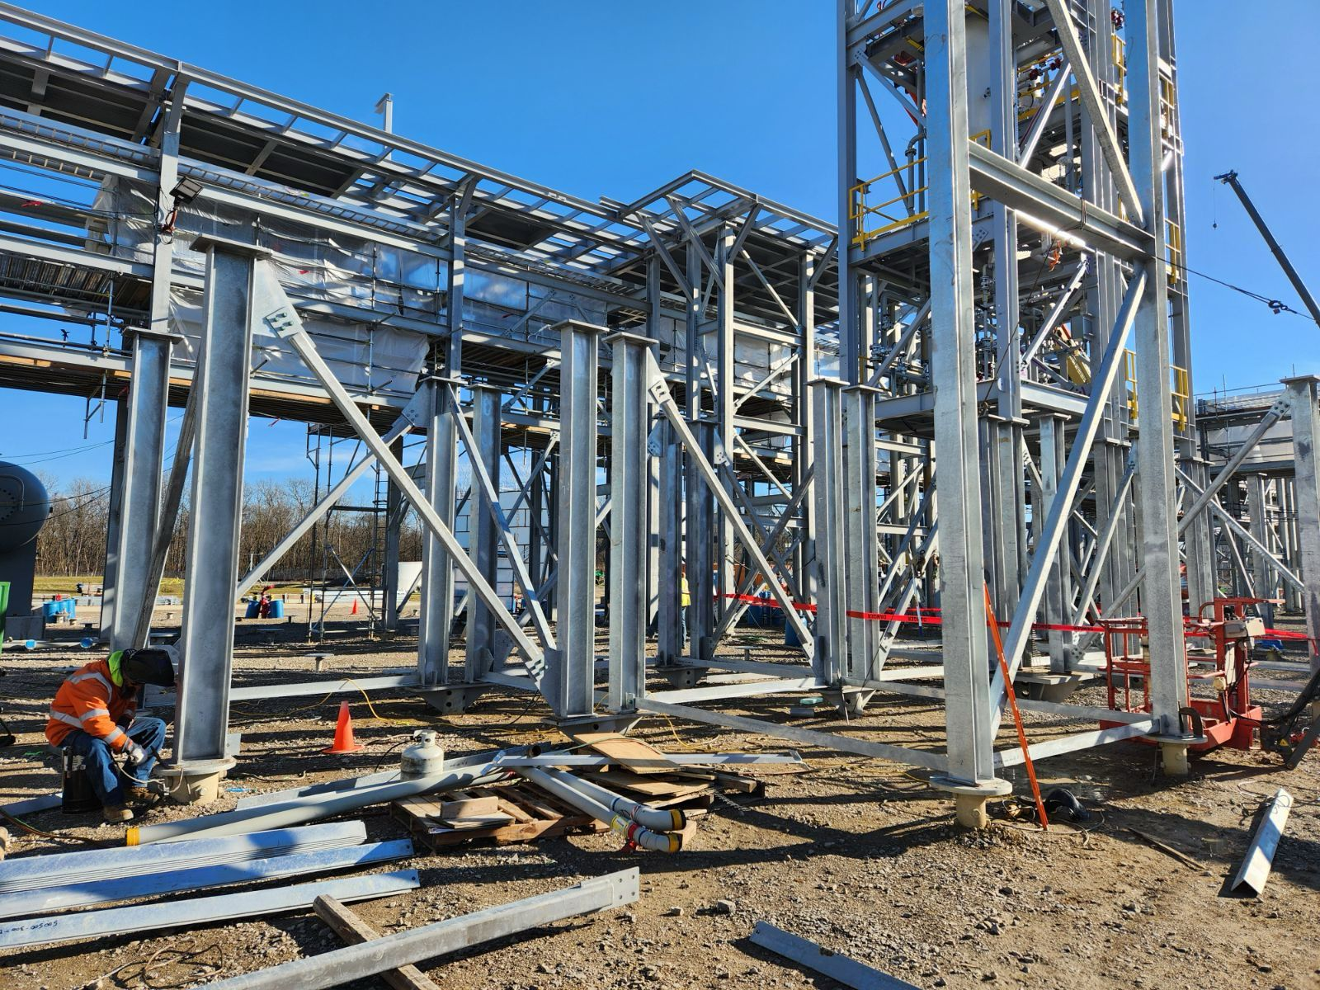
ZEESF Project Highlights
    Steel Structure for Chemical processing plant weight of ~ 260,000 Ibs.
FROM SPARKLES TO STEEL

Slide 29
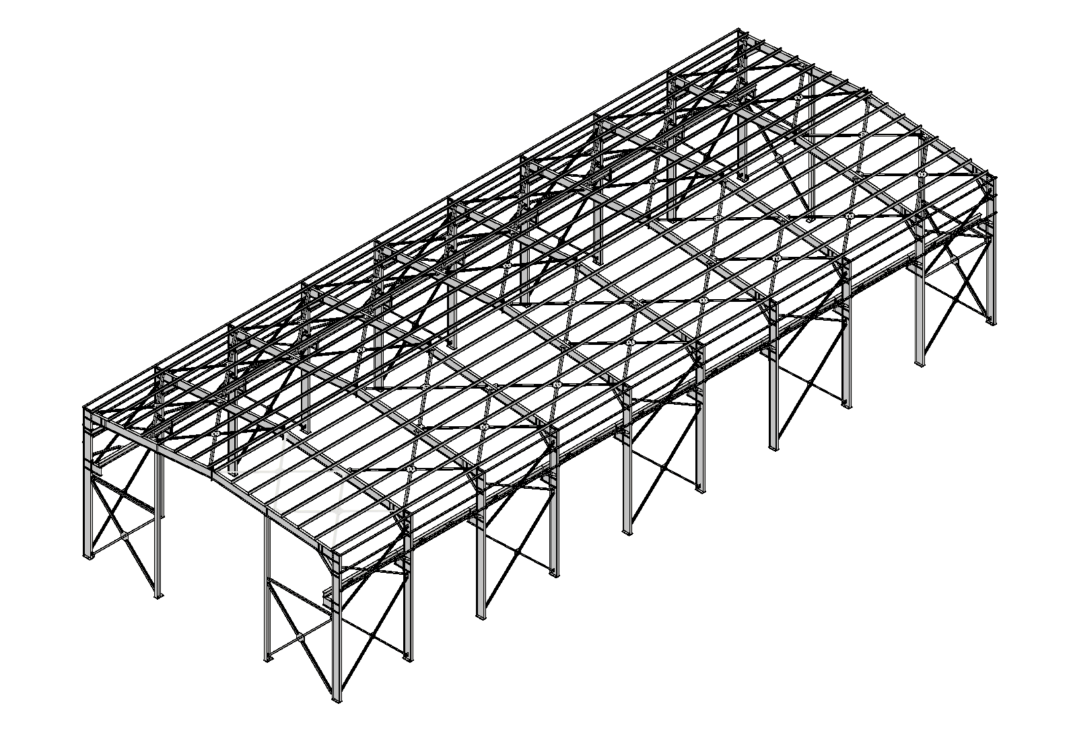
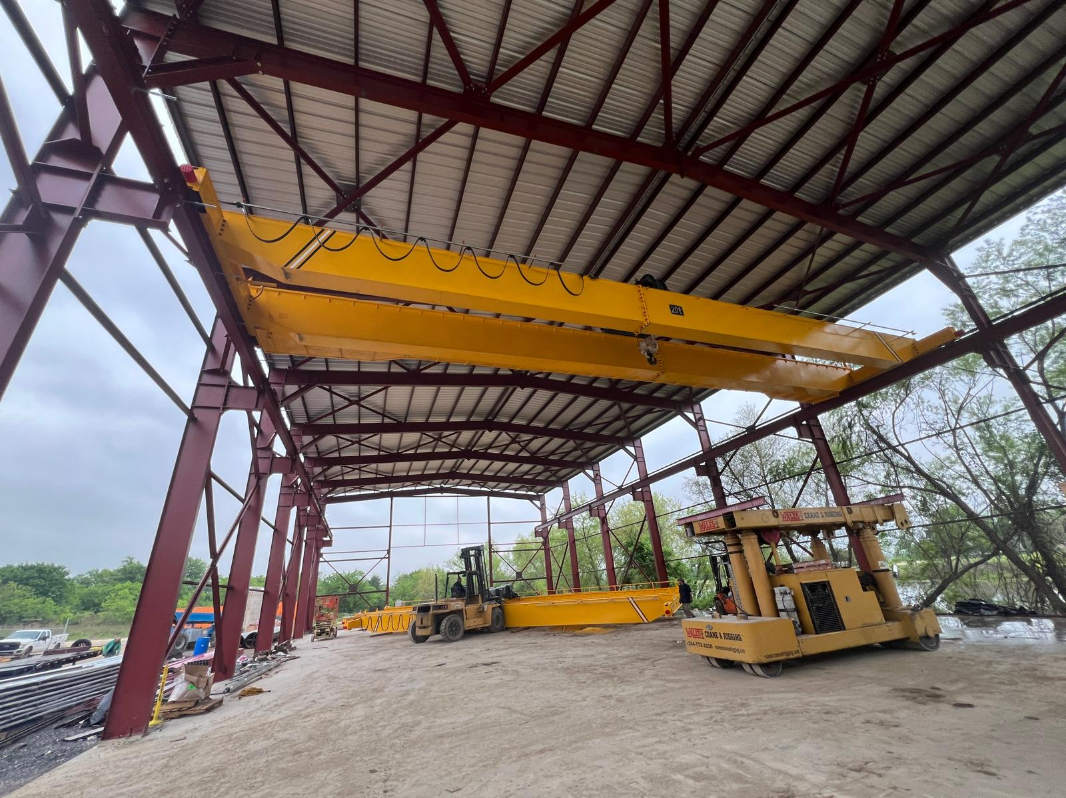
ZEESF Project Highlights
    Workshop shed for manufacturing workshop. Whole Engineering and detail drawings of the Workshop shed is done by ZEESF.
FROM SPARKLES TO STEEL

Slide 30
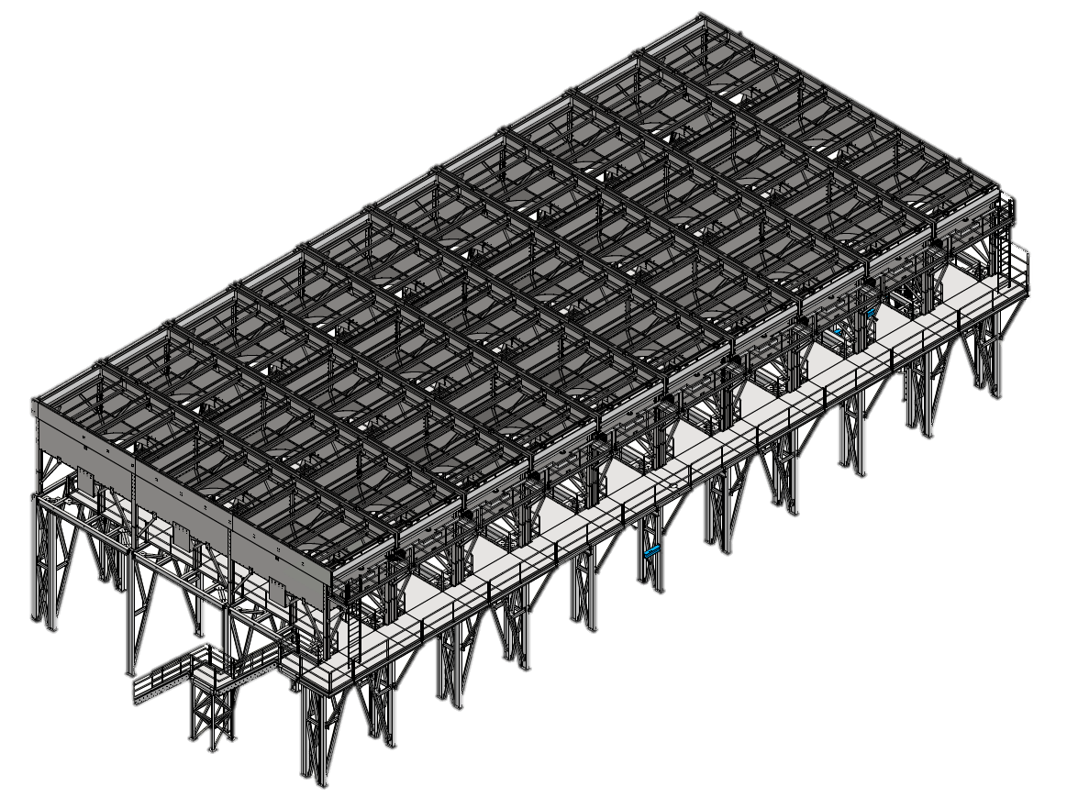
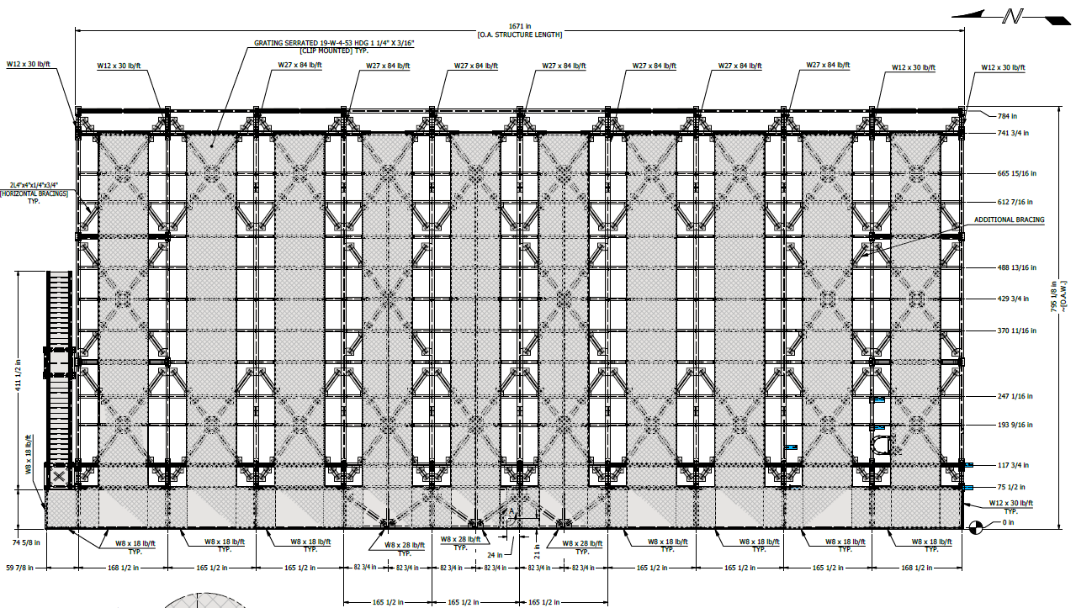
ZEESF Project Highlights
    7000 TR refrigeration system’s 10 bays of Air cooled condensers with its supporting structure
FROM SPARKLES TO STEEL

Slide 31
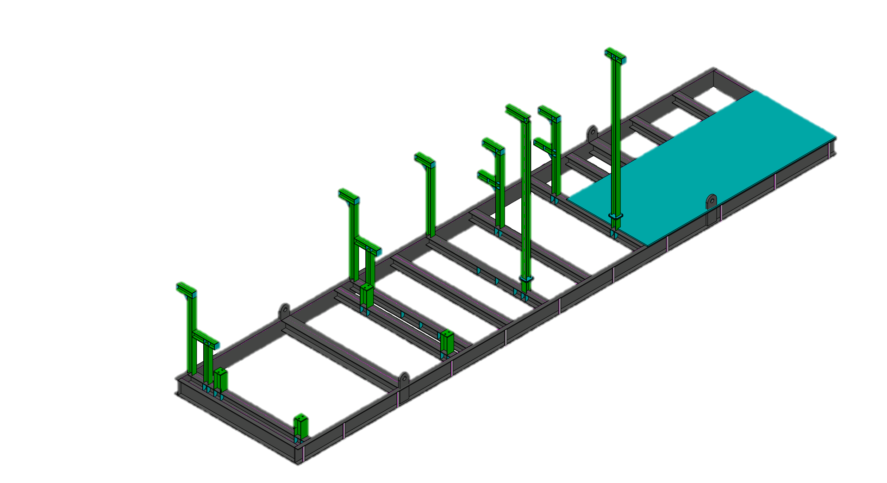
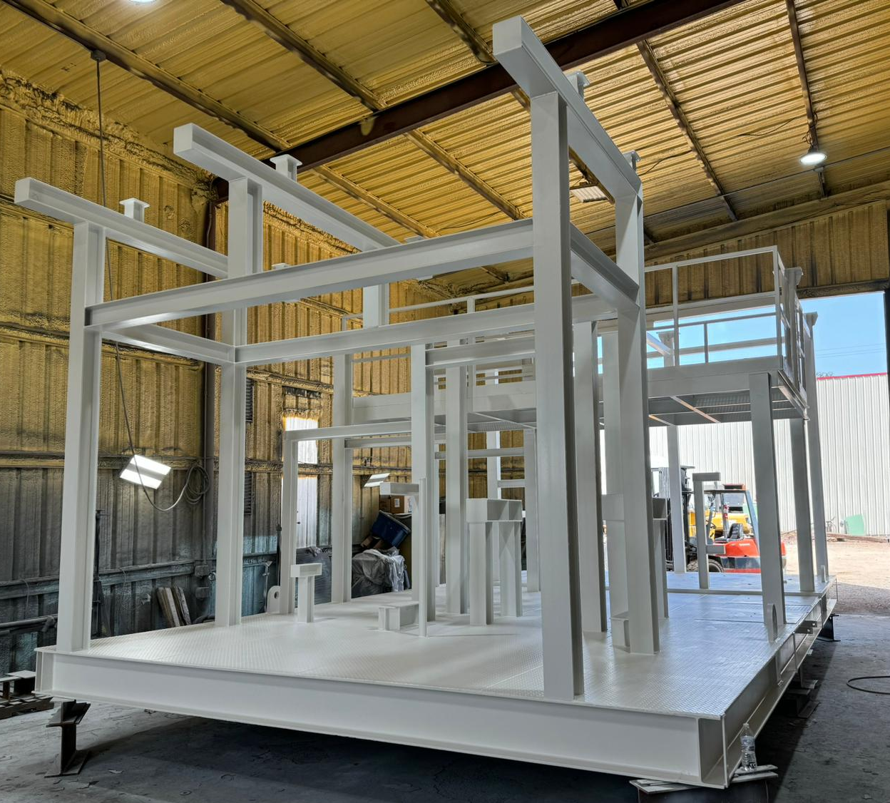
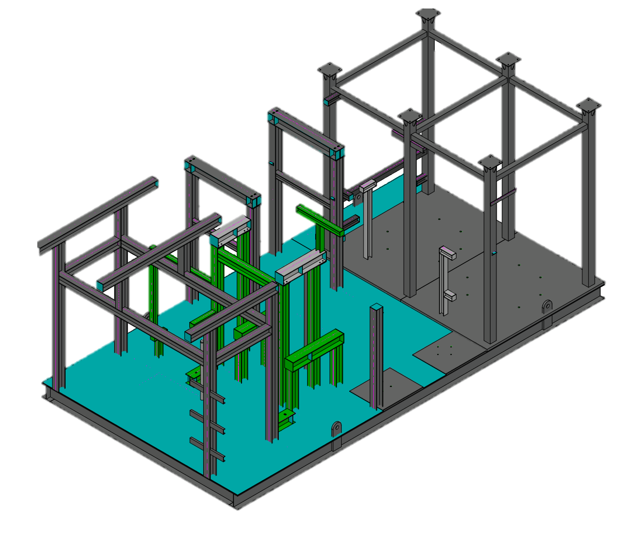
ZEESF Project Highlights
    ZEESF has design many steel structures
FROM SPARKLES TO STEEL

Slide 32
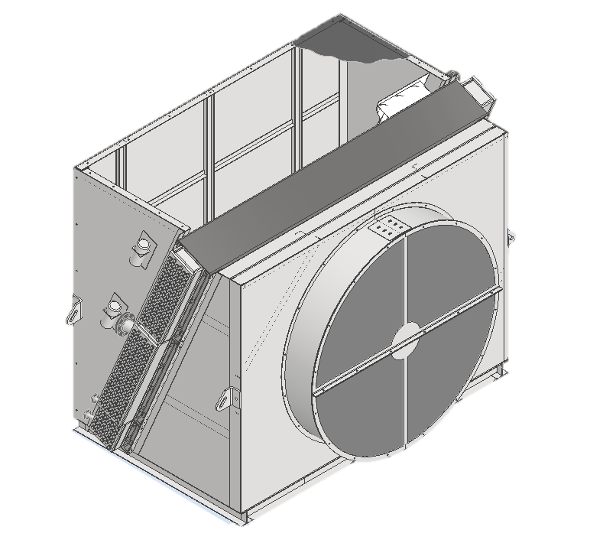
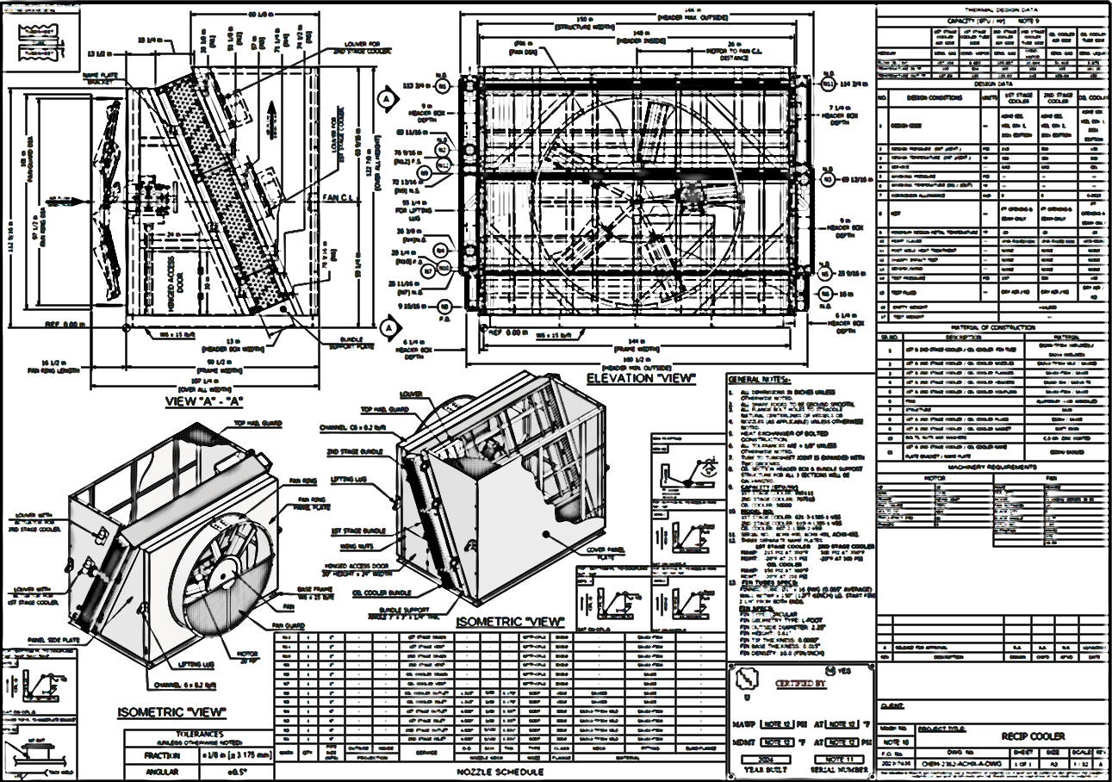
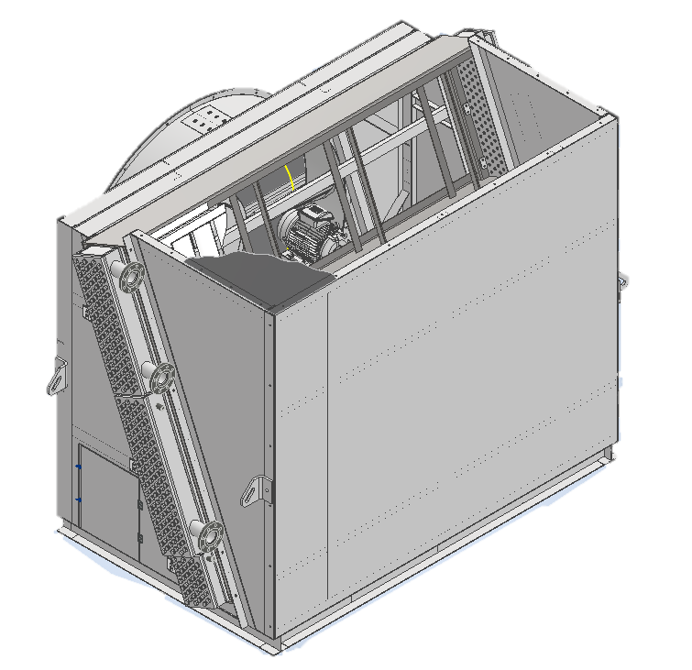
ZEESF Project Highlights
    ZEESF designed Recip Cooler for client which contains two sloped bundles for gas and oil cooler.
FROM SPARKLES TO STEEL

Slide 33
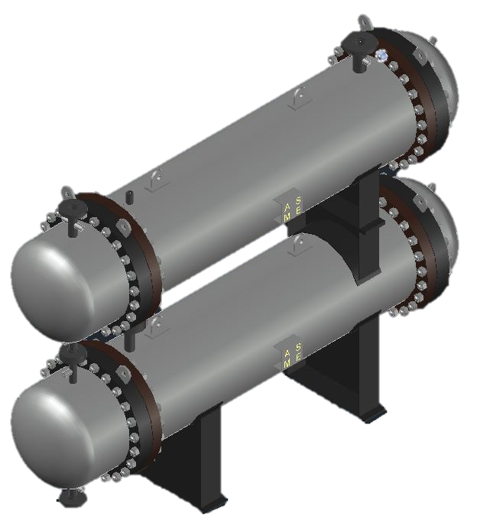
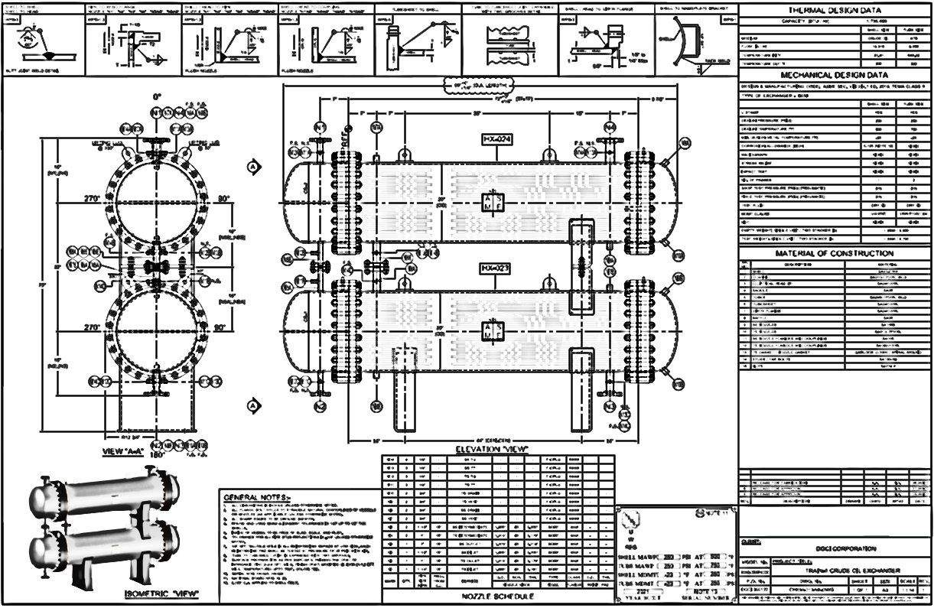
ZEESF Project Highlights
    Customized stacked heat exchangers detail engineering for oil & gas client.
FROM SPARKLES TO STEEL

Slide 34
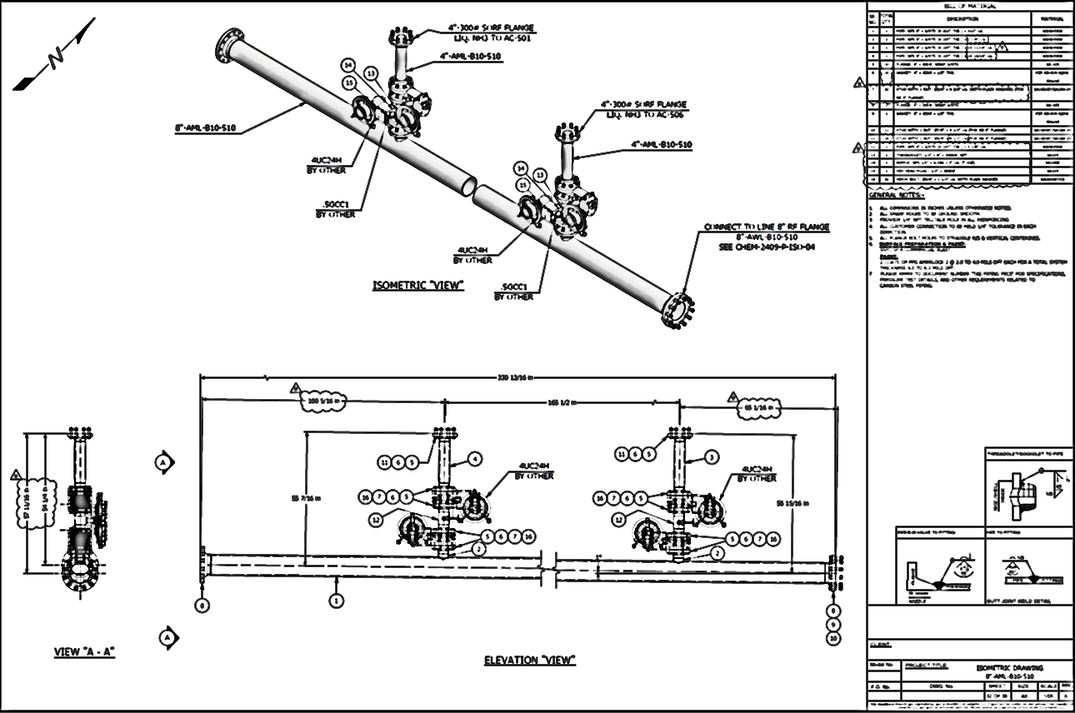
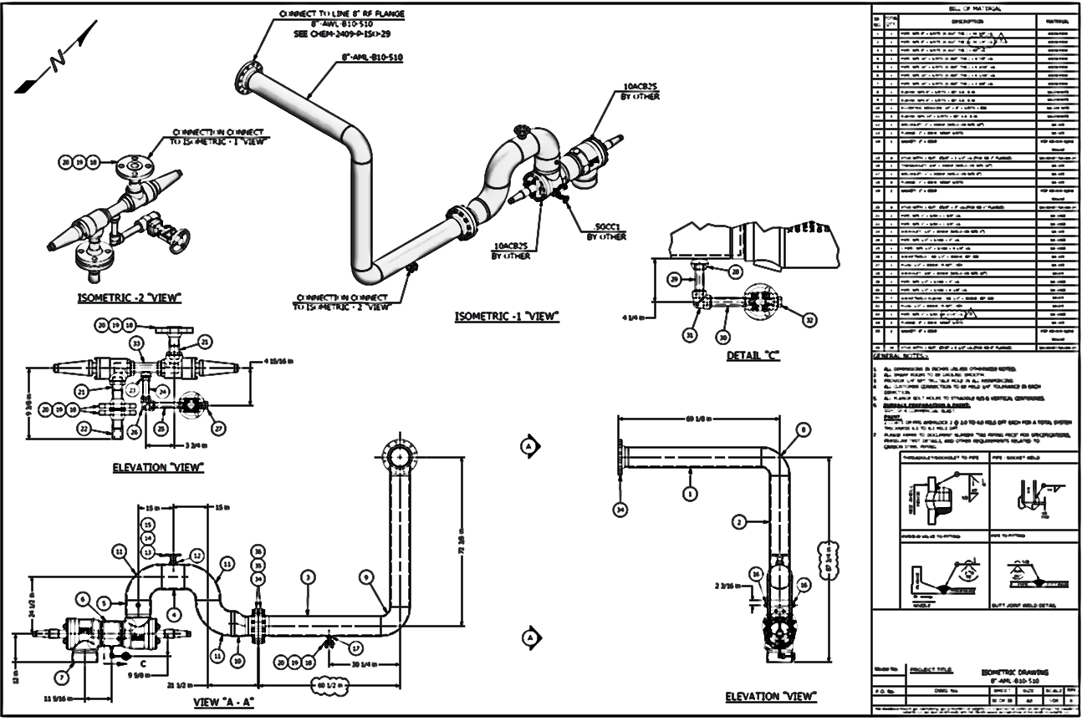
ZEESF Project Highlights
    Plant piping Isometrics
FROM SPARKLES TO STEEL

Slide 35
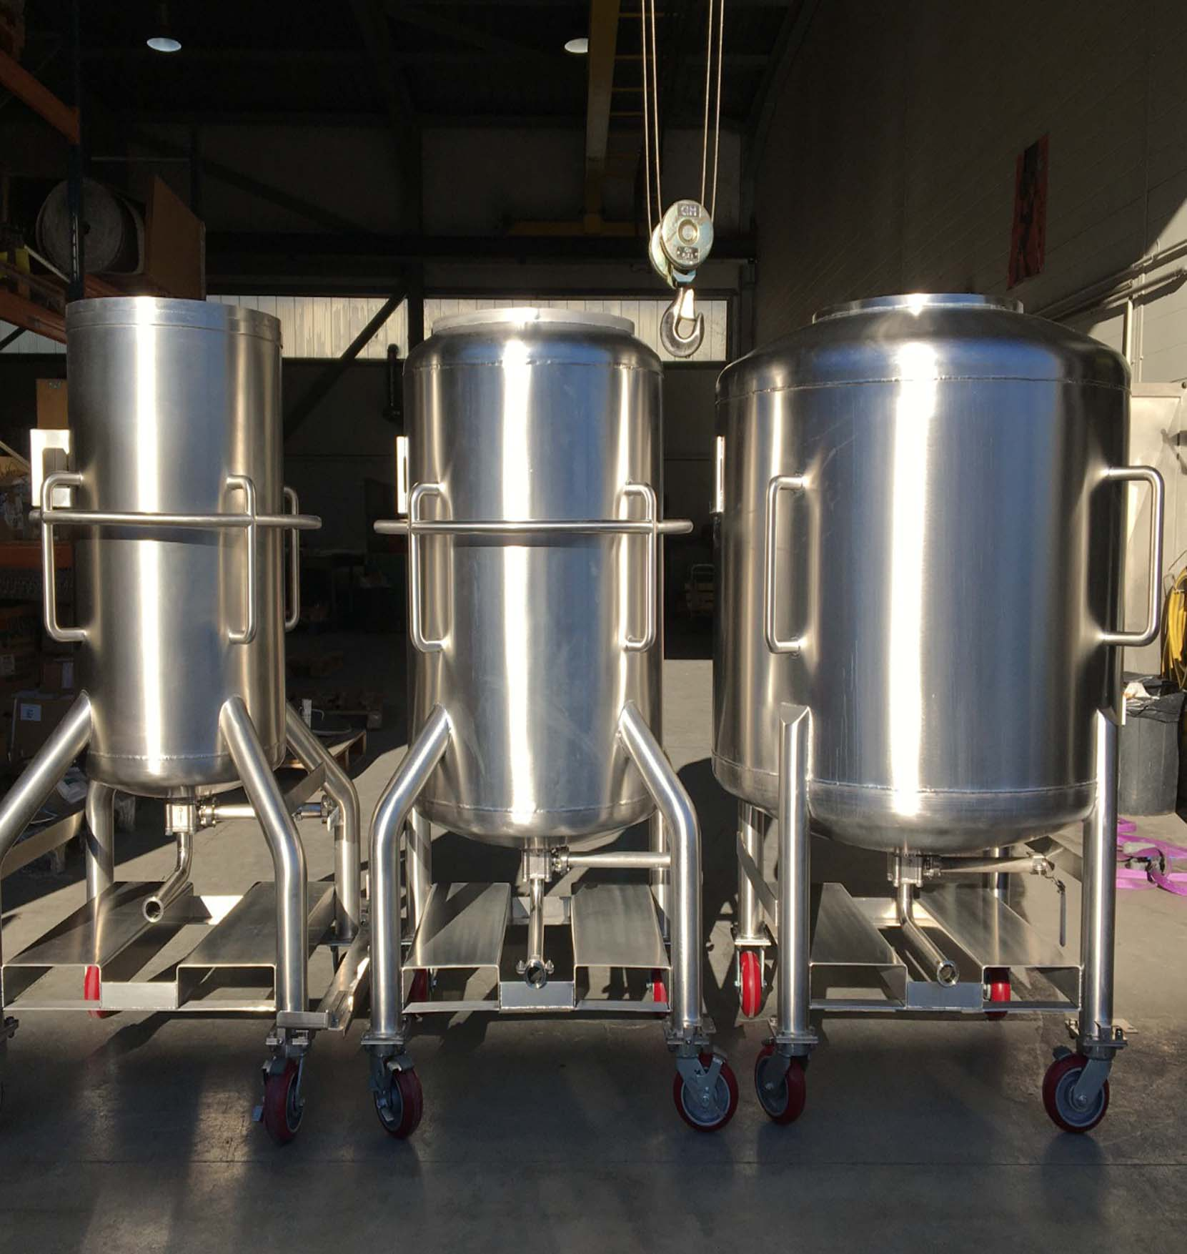
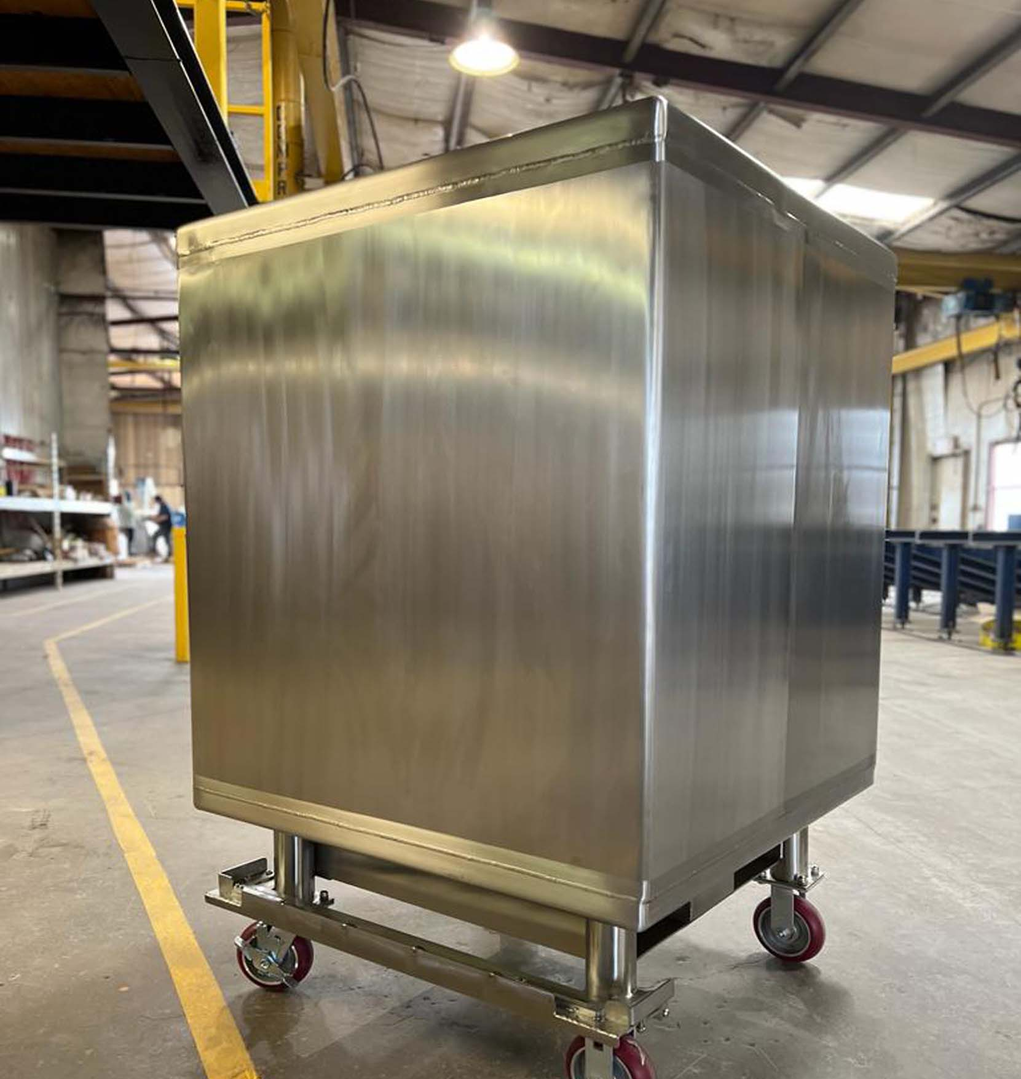
ZEESF Project Highlights
    Storage tanks detail engineering for cosmetic industries.
FROM SPARKLES TO STEEL

Slide 36
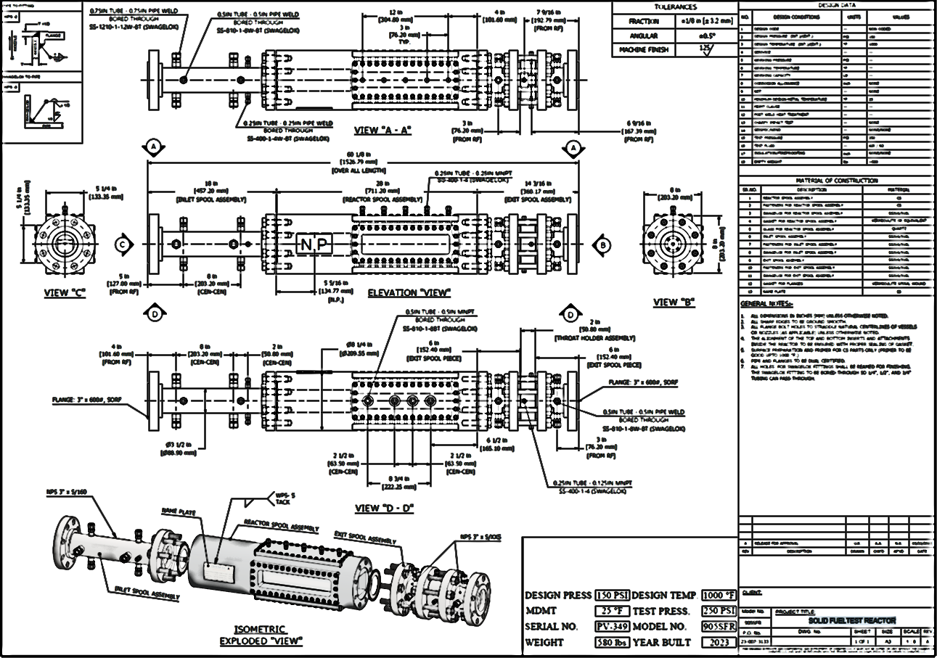

ZEESF Project Highlights
    Detail engineering for specialized items.
FROM SPARKLES TO STEEL

Slide 37
Privacy Policy of ZEESF LLC
At ZEESF LLC, we prioritize the privacy and security of your personal and business information. We are committed to safeguarding all data shared with us through industry-standard security measures.
Data protection
  Confidentiality: All customer information, proprietary designs, and documents are kept confidential.
  Access control: Only authorized employees and contractors with confidentiality agreements can access your data.
  Security: we use encryption, secure data storage, and regular audits to protect your information from unauthorized access.
We use your information solely for:
    Providing requested services
    Responding to inquiries
    Fulfilling contractual obligations
    We do not share your information with third parties unless required by law or authorized by you.
FROM SPARKLES TO STEEL

Slide 38
CONTACT US
For any questions or concerns, please contact us at:
Email: info@zeesf.com
Phone: +1 (817) 909-7745
Address: 990 HWY 287 NSTE 106-101MansfieldTexas, USA - 7606
FROM SPARKLES TO STEEL

